Slide 1
Sarah Langa Siu - Chief Registrar
INDUCTION OF NEWLY APPOINTED ACTING MAGISTRATES GRADE ONE
30^{h} October 2023 – Colline Hotel Mukono
THE STRUCTURE & FUNCTIONS OF THE JUDICIARY AND THE ADMINISTRATION OF THE JUDICIARY ACT

Slide 2
FOCUS OF THE PRESENTATION
Introduction & Mandate of the Judiciary
Operations and Structure of the Judiciary
The Structural leadership in the Judiciary - Hierarchy and Departments
Key Functions of the Judiciary
Functions of Magistrates Grade One
Highlights of AJA

Slide 3
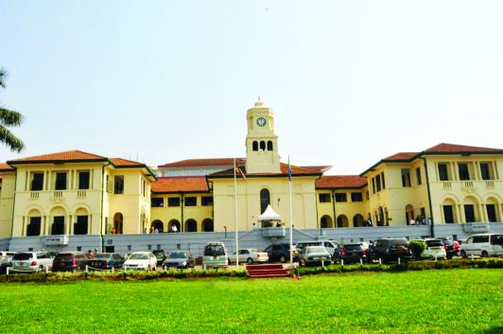
INTRODUCTION
- Judicial power is derived from the people - Article 126 (1) of the Constitution
- Article 128 asserts the Independence of Judiciary
The Judiciary is an arm of Government
  Established under Chapter 8 of the Constitution of the Republic of Uganda
  The Administration of the Judiciary Act, 2020

Slide 4
MANDATE
Core mandate is adjudication of civil and criminal matters under Article 126 (2) of the Constitution. Guiding principles:
  justice shall be done to all irrespective of their social or economic status;
  justice shall not be delayed;
  adequate compensation shall be awarded to victims of wrongs;
  reconciliation between parties shall be promoted; and
  substantive justice shall be administered without undue regard to technicalities.

Slide 5
CONTRIBUTION TO THE ECONOMY
The Judiciary not a consumer but plays a role in the economic transformation of the economy and in creating wealth to drive Uganda to middle income status, in line with the country’s Vision 2040, and the National Development Plan III inter alia, through:
  Revenue collection through court fees and fines;
  Creating peaceful societies by keeping away murderers, terrorists, robbers, embezzlers and all other criminals;
  Resolution of commercial and land disputes thereby liberating money and other factors of production

Slide 6
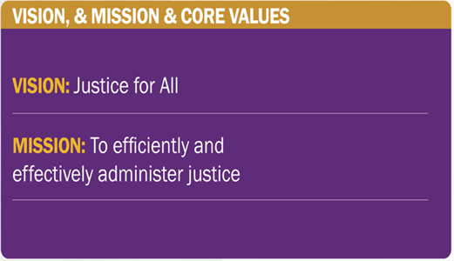

Slide 7
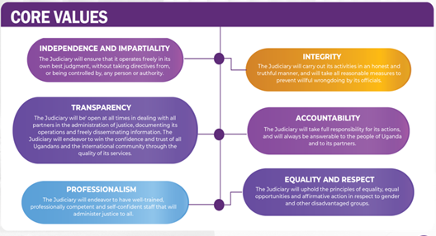

Slide 8
OPERATIONS & STRUCTURE OF THE JUDICIARY
Article 129 (1) provides the structure under which the Judiciary operates;
    The Supreme Court
    The Court of Appeal/Constitutional Court
    The High Court (Divisions and Circuits)
    Magistrates Courts

Slide 9
OPERATIONS & STRUCTURE OF THE JUDICIARY
Supreme Court: Articles 130-132 of the Constitution
  Established under Article 130
  Headed by the Hon. Chief Justice
  Final Court of appeal and has original jurisdiction in Presidential elections under the Presidential Elections Act, as amended.
Court of Appeal/Constitutional Court:
  Established under Articles 134 -137 of the Constitution
  Headed by the Deputy Chief Justice
  Determines appeals from the High Court and
  Is a final appellate Court for Parliamentary and LC V election petitions under the Parliamentary Elections Act and The Local Government Act, as amended.

Slide 10
OPERATIONS & STRUCTURE OF THE JUDICIARY
High Court: Articles 138-140 of the Constitution
  Established under Article 138 of the Constitution
  Headed by the Principal Judge
  Has unlimited original jurisdiction in all matters and also determines appeals from subordinate courts
  Exercises general powers of supervision over Magistrate’s Courts - S. 17 of the Judicature Act, as amended.
  20 operational Circuits across the country, more to be gazatted and operationalized.
  7 Divisions in Kampala (Civil, Criminal, Land, ICD, ACD, Commercial & Family)

Slide 11
OPERATIONS & STRUCTURE OF THE JUDICIARY
Magistrates Courts:
  One of the subordinate Courts provided for under Article 129 (1) (d) of the Constitution.
  Magisterial areas and their establishment is provided for under Sections 2 and 3 of Magistrates Courts Act (MCA) - Currently 82/160 Chief Magisterial areas
  Grades of Magistrates - S.4 (2) of the MCA as amended by Act 7/2007 provides for three grades of Magistrates;
    Chief Magistrate
    Magistrate Grade I
    Magistrate Grade II (phase out ongoing)

Slide 12
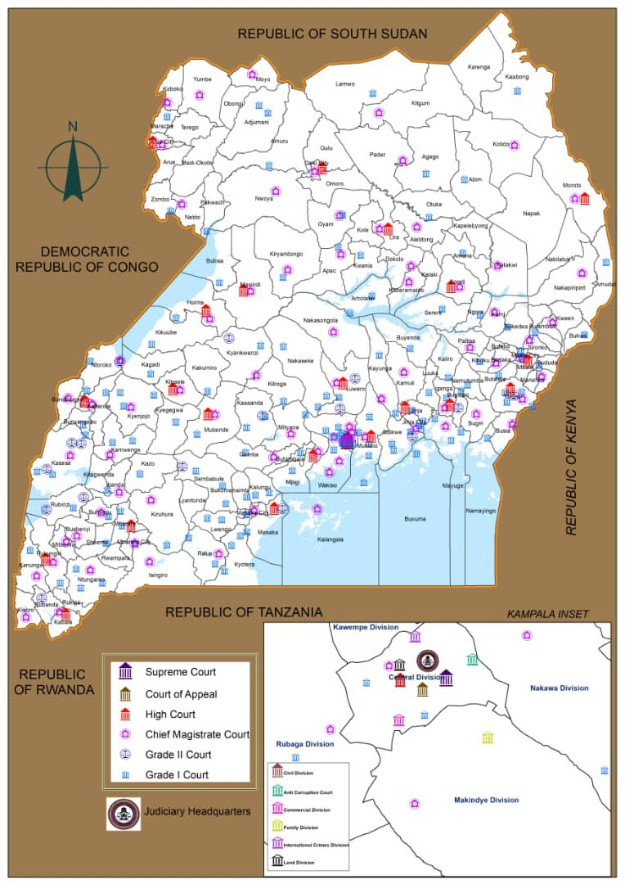
COVERAGE OF THE JUDICIARY

Slide 13
THE STRUCTURAL LEADERSHIP
OF THE JUDICIARY

Slide 15
Structural leadership of the judiciary
Chief Justice
  Head of the Judiciary and responsible for the administration and supervision of all courts in Uganda- Article 133 (1)
  Issue orders and directions to courts necessary for the proper and efficient administration of justice- Article 133 (2)
  Assign administrative duties of a higher status to a judicial officer for a specified period of time- S. 3 (a) AJA, 2020
  Establish performance and evaluation systems for the Judiciary- S. 3 (b) AJA, 2020
  Chairperson of the Judiciary Council- S. 4 (2) AJA, 2020

Slide 16
Structural leadership of the judiciary
Deputy Chief Justice
  Deputize the Chief Justice as and when the need arises- Article 136 1 (a)
  Head of the Court of Appeal and in that capacity assists the Chief Justice in the administration of that Court
  Perform such other functions as may be delegated or assigned by the Chief Justice

Slide 17
Structural leadership of the judiciary
Principal Judge
  Head of the High Court and in that capacity assists the Chief Justice in the administration of the High Court and the subordinate Courts-Article 141 (1) (a)
  Perform such other functions as may be delegated or assigned by the Chief Justice-Article 141 (1) (b)

Slide 18
Structural leadership of the judiciary
Chief Registrar
  Established under Article 145 of the Constitution, S. 43 of the Judicature Act and duties are provided for under Section 15 (2) of the AJA, 2020
  He/she performs judicial functions vested in him/her by law.
  He/she gives effect to policies and directions of the Chief Justice, Deputy Chief Justice and the Principal Judge
  He/she gives effect to the work of overseeing judicial operations of all the Court of Judicature.
  Monitoring and enhancing the quality of services and official procedures.
  Communicating with government and the public on matters relating to the judiciary or any other matter which government may be concerned with

Slide 19
Structural leadership of the judiciary
Chief Registrar
  Implement the Judicial activities in the judiciary strategic plan.
  Assisting the Chief Justice, Deputy Chief Justice and the Principal Judge in the facilitation and supervision of Courts
  Linking the Judiciary and the Judicial Service Commission on appointments, promotions and disciplinary matters relating to Registrars and magistrates
  Secretary of the Judiciary Council – S (6) AJA, 2020
  Any other matters assigned by the Chief Justice, Deputy Chief Justice or Principal Judge and he/she reports to the Chief Justice in the exercise of his/her duties.

Slide 20
Structural leadership of the judiciary
The Secretary to Judiciary
  Is the accounting officer and chief administrator for administrative/non judicial staff serving in the judiciary
  Duties under Section 17 (2) of the AJA, 2020
  Organization of the Judiciary
  Tendering advise to the Chief Justice in respect of the administrative business of the Judiciary
  Implementing policies of the Government of Uganda
  Implementing the administrative activities in the Judiciary Strategic plan
  Expenditure of public funds by or in connection with the Judiciary

Slide 21
STRUCTURAL LEADERSHIP - REGISTRARS
Registrars:
Established under Article 145 of the Constitution, Section 43 of the Judicature Act and Section 16 of the AJA. 12 Registrars that support the Chief Registrar. 9 have been in existence for some time, 3 were established in the new structure of 2021.
Supreme Court
Court of Appeal
High Court
Inspector of Courts
Magistrates Affairs and Data Management
Planning, Research and Development
Human Resource Development and Training
Alternative Dispute Resolution
Public Relations and Communications
Private Legal Secretary- CJ,DCJ and PJ

Slide 22
Structural leadership of the LOWER BENCH

Slide 23
Structural leadership –DUTIES of OFFICE BEARERS
  The schedule of duties and key performance indications for Registrars and Magistrates 2016 highlights the key functions and duties for Registrars and Magistrates.
  The said schedule is under review for the development of a comprehensive scheme of service that unpacks person specifications; behavioral competences, duties and responsibilities, key performance indicators among others

Slide 24
STRUCTURAL LEADERSHIP- DEPARTMENTS & UNITS
Departments:
5 departments and 2 specialized units that provide technical support to judicial services through the Secretary to the Judiciary:
Finance and Administration Department
Human Resource Management Department
Engineering & Technical Services Department
Information & Communication Technology Department
Policy and Planning Department
Internal Audit Unit
Procurement & Disposal Unit

Slide 25
STRUCTURAL LEADERSHIP – DEPARTMENTS AND UNITS

Slide 26
THE FUNCTIONS OF THE JUDICIARY

Slide 27
KEY FUNCTIONS OF THE JUDICIARY
Adjudication of civil and criminal matters- Article 126 (2) of the Constitution. Guiding principles
    justice shall be done to all irrespective of their social or economic status;
    justice shall not be delayed;
    adequate compensation shall be awarded to victims of wrongs;
    reconciliation between parties shall be promoted; and
    substantive justice shall be administered without undue regard to technicalities.
Interpret and defend the Constitution and the laws of Uganda;

Slide 28
KEY FUNCTIONS OF THE JUDICIARY
Promote the rule of law;
Promote human rights of individuals and groups
Enroll and license advocates
License and discipline Court Bailiffs;

Slide 29
KEY FUNCTIONS OF THE JUDICIARY
7. Keep custody of laws enacted as well as disseminate legal literature;
8. Receive government revenue accruing from the Courts;
9. Introduce modalities for alternative dispute resolution (ADR) to reduce the burden of cases on the Courts

Slide 30
FUNCTIONS OF MAGISTRATES
Schedule of duties

Slide 31
THE administration of the JUDICIARY act, 2020

Slide 32
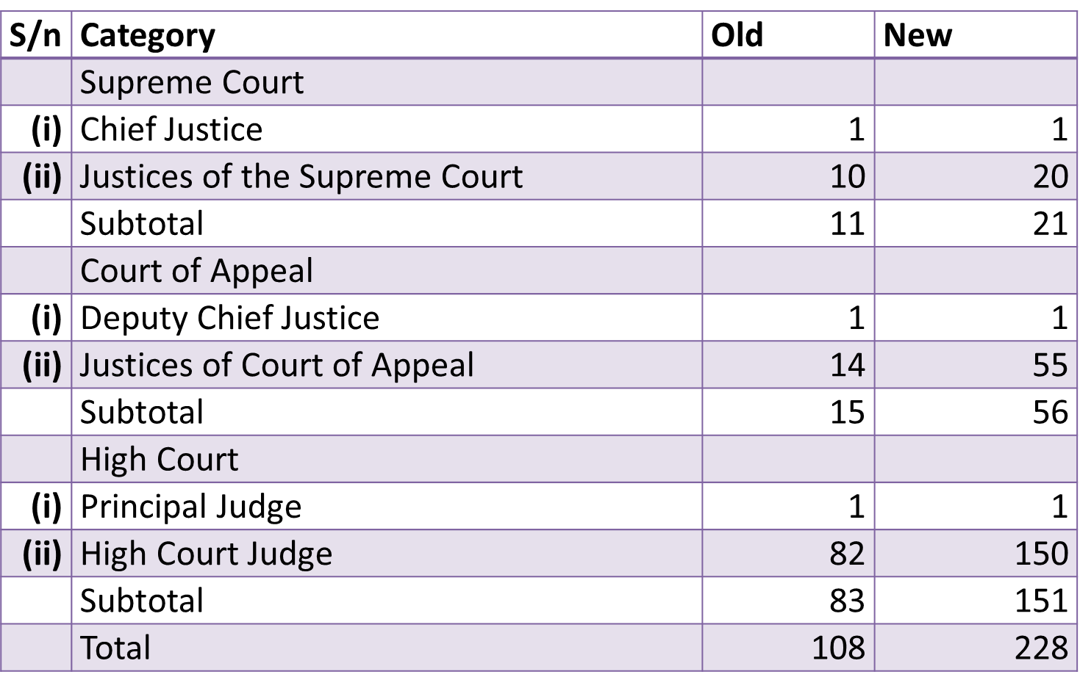
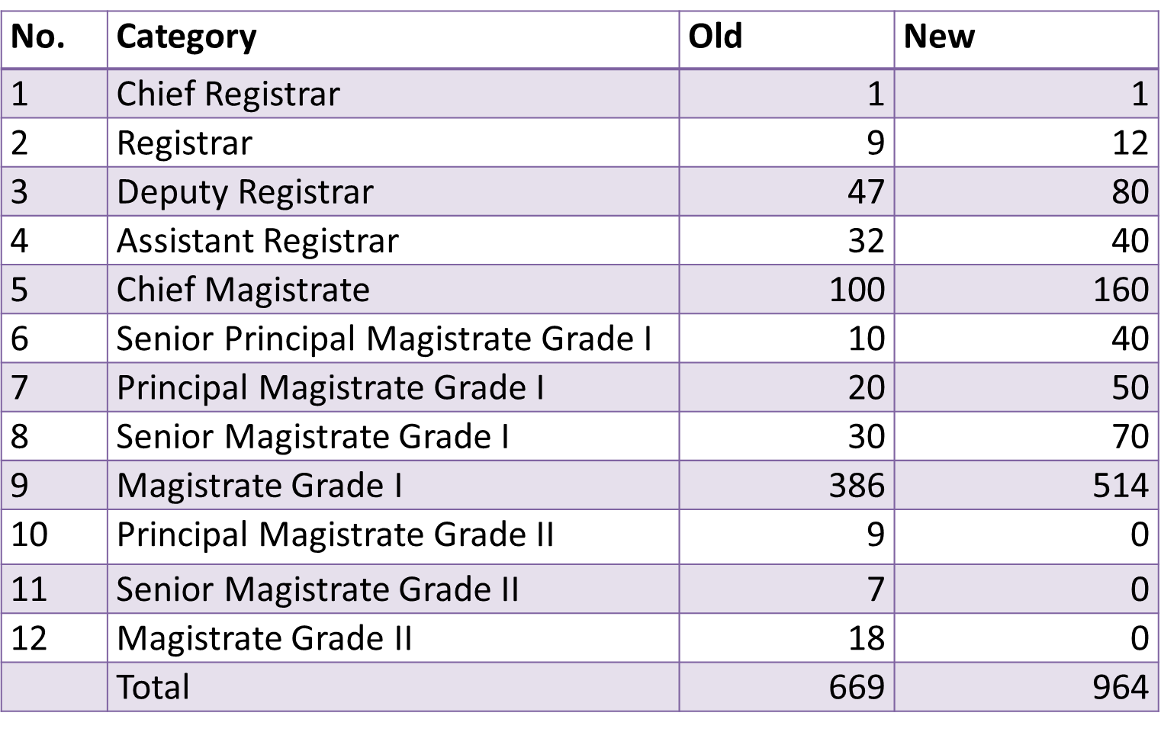
HIGHLIGHTS OF AJA
Summary of the new structure for the Upper Bench
a) The Judiciary Service – S. 13 AJA
Summary of the new structure for the Lower Bench

Slide 33
HIGHLIGHTS OF AJA
3 Coram's of the Supreme Court
  8 regional Courts of Appeal in Mbale, Gulu, Arua, Jinja, Masaka, Mbarara, Fort Portal and Soroti
  Operationalization of the 20 High Court Circuits and more gazetted
  Chief Magistrate in every district
  Magistrate Grade One in every Constituency
  Magistrates Grade One –Research function
b) Expanded Structure

Slide 34
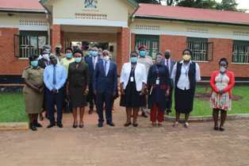
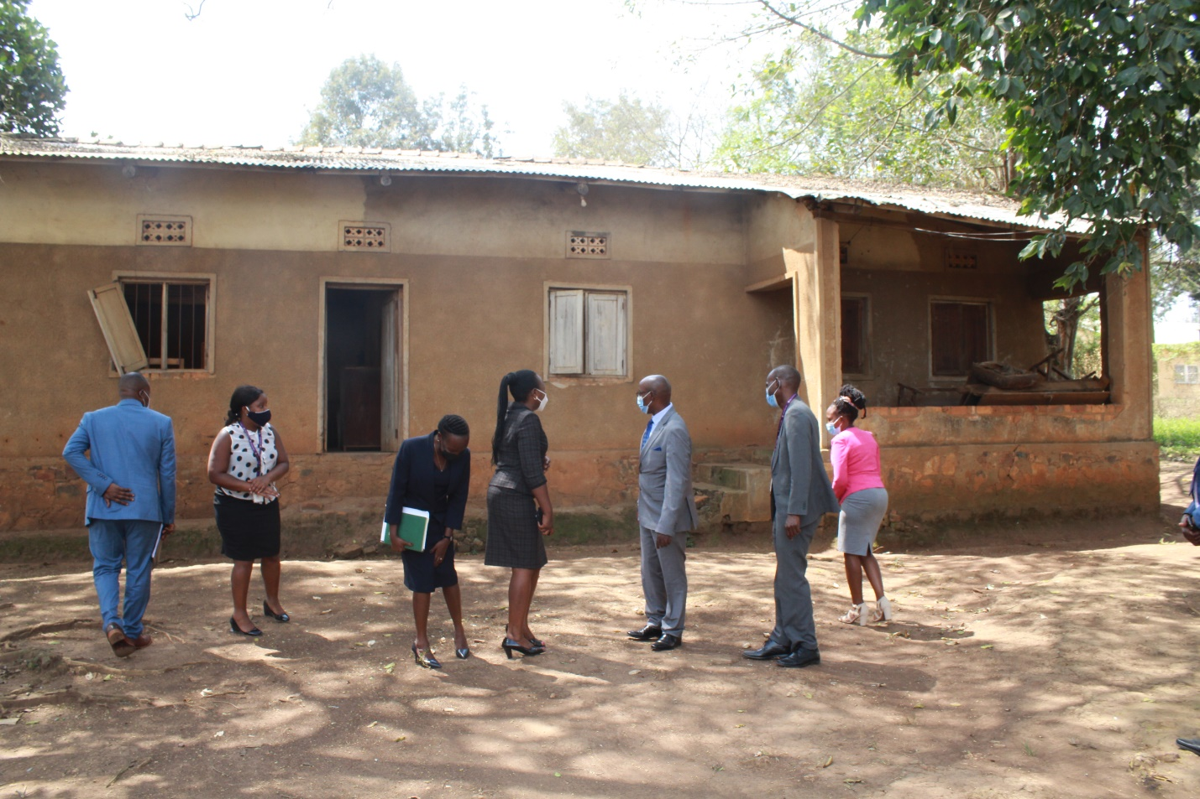
HIGHLIGHTS OF AJA
c) Strengthen Inspection of Courts – Part III AJA
  Inspectorate creature of statute- Part III of AJA
  Regulations to govern the Inspectorate
  expand capacity of the Inspectorate
  decentralize inspection
  provide vehicles, training etc

Slide 35
HIGHLIGHTS OF AJA
  360 degree performance weights
d) Performance Management System - Part V – Section 18 AJA

Slide 36
HIGHLIGHTS OF AJA
Construction of the state of the art modern training facility out of Kampala- concept being developed
Develop a training curriculum and calender for Judicial, non judicial staff and others
  routine refresher courses for judiciary
  courses JLOS agencies
  courses for LC Courts
2 weeks induction training
Accreditation of the JTI by the National Council for Higher Education (NCHE)
e) Expansion of the Judicial Training Institute (JTI) – Part VI

Slide 37
HIGHLIGHTS OF AJA
f) Development of Regulations under the Act S. 40 AJA
  Administration of the Judiciary ( Establishment of Committees) Regulations, 2022
  Administration of the Judiciary (Judiciary Service) Regulations, 2022
  Administration of the Judiciary (Inspectorate of Courts) Regulations, 2022
  Administration of the Judiciary (JTI) Regulation, 2022

Slide 38
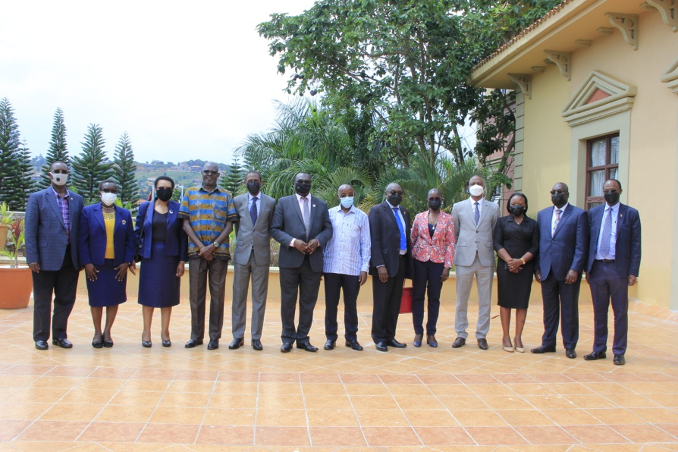
HIGHLIGHTS OF AJA
g) The Judiciary Council
g) Judiciary Council
  -Sections 4 and 5 AJA

Slide 39
PROGRESS OF THE NEW JUDICIARY AT A GLANCE
SN | ITEM | STATUS OF IMPLEMENTATION
1. | Judiciary Service – Structure and Establishment | Judicial Approved by Cabinet (228- Superior Courts & 964- lower bench) Amendment of Judicature Act and Resolution of Parliament for appellate Courts and High Court- work in progress Some vacancies declared, promotions have taken place, new appointments, other promotions and appointments pending Non Judicial Staff Approved by Cabinet this year Recruitment ongoing
2. | Improved remuneration | Judicial Approved Non Judicial Pending
3. | Judiciary Council | Functional and conducting business
4. | Increased budget (Session and operational fund allocations) | Greatly improved. FY 2021/22- 376 billion from 199 billion in FY 2020/2021. in FY 2022/23- 281 billion
5. | Judiciary fleet | From 263 vehicles and 106 motorcycles supplied in FY 2021/2022 to 332 vehicles and 136 motor cycles supplied in the subsequent Financial Years Registrars and Heads of Department for the first time received new vehicles
6. | Performance Management System | Consultancy on case weights ongoing to complete the tool

Slide 40
PROGRESS OF THE NEW JUDICIARY AT A GLANCE- CONTD
SN | ITEM | STATUS OF IMPLEMENTATION
7. | Appellate structures construction projects and a number of construction projects | On course- Supreme Court- December 2023, Court of Appeal- January 2024
8. | Judiciary Strategic Plan V | Being implemented
9. | Payment of retirement benefits | On course and in a timely manner
10. | Health insurance | Being implemented
11. | Annual Performance Reports for the past three Financial Years Published | Report for FY 2022/23 was launched on 20th October 2023
12. | Development of Regulations under AJA | Work in progress- Judiciary Service, JTI, Inspectorate, Committees

Slide 41
THANK YOU

