Slide 1
Capacity Building Workshop on Investigation, Prosecution, and Adjudication of Money Laundering and Terrorism Financing Cases
Johnson Tumusiime
CDPO,C|IH®
Email: johnson.tumusiime@nita.go.ug

Slide 2
Content
Criminal Usage of Digital Payment Methods
Tools to Investigate Criminal Usage of Virtual Assets
Cyber Enabled Financial Crime
Digital Evidence Collection, Preservation, and Presentation
Q&A

Slide 3
Digital Payments Methods
Digital payment methods encompass a wide range of technologies and platforms that facilitate electronic payments

Slide 4
Digital Payments Methods - Trends
Trend: Increasing use in both legitimate and criminal activities
Convenience and Efficiency | Growth in E-commerce |Financial Inclusion| Enhanced Security
E-Fraud and Identity Theft | Money Laundering | Cybercrime |Dark Web Transactions

Slide 5
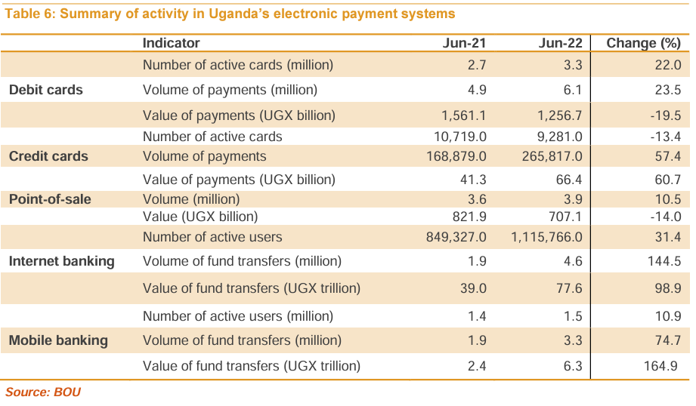

Slide 6
Criminal Usage of Digital Payment Methods
E- Fraud: in digital payments often involves deceptive practices to gain unauthorized access to funds. Common methods include phishing, card skimming, and online scams.
Identity Theft: involves stealing personal information such as Social Security numbers, bank account details, or credit card numbers to commit fraud.
Money Laundering: is the process of making illegally-gained proceeds appear legal. This is often done by moving money through a complex sequence of banking transfers or commercial transactions.
Terrorism Financing: involves the solicitation, collection, or provision of funds with the intention of using them to support terrorist acts or organizations.

Slide 7
Case Studies
Money Laundering:
Case Study: Liberty Reserve Case (2013)
Overview: Liberty Reserve, a digital currency service based in Costa Rica, was used to launder more than $6 billion over seven years. It facilitated anonymous money transfers without proper oversight.
Outcome: The U.S. government shut down Liberty Reserve, and its founder was arrested and sentenced to 20 years in prison. This case underscored the potential for digital currencies to be exploited for money laundering.
Terrorism Financing:
Case Study: Bitcoin and the Funding of Terrorism (2015-2020)
Overview: Various terrorist groups, including ISIS, used Bitcoin and other cryptocurrencies to finance their operations. These groups solicited donations through social media and encrypted messaging platforms.
Outcome: Law enforcement agencies tracked and seized cryptocurrency assets linked to terrorism financing. This led to increased scrutiny and regulation of cryptocurrency exchanges to prevent misuse for illegal activities.

Slide 8
How Criminals Exploit Digital Payment Methods
Phishing and Social Engineering:
Criminals use deceptive emails, texts, or websites to trick individuals into revealing personal information, such as login credentials or credit card details.
Card Skimming and Cloning:
Devices are installed on ATMs or point-of-sale terminals to capture card details during transactions. The data is then used to create counterfeit cards.
Malware and Ransomware:
Malware is used to infiltrate systems and steal data or hold it hostage. Ransomware encrypts a victim's data and demands payment, often in cryptocurrencies, for the decryption key.
Virtual Assets Exploitation:
Virtual Assets offer a degree of anonymity, making them attractive for illicit transactions, money laundering, and terrorism financing.
Fraudulent Online Merchants: Fake online stores or auction sites lure customers into paying for goods that are never delivered. These sites often look legitimate but disappear after collecting payments.
Money Mules and Mule Accounts: Criminals recruit individuals, often unwittingly, to transfer illegally obtained funds through their bank accounts to obscure the money trail.
SIM Swapping:
Criminals gain control of a victim's phone number by tricking the telecom provider into transferring the number to a SIM card they control. This allows them to bypass two-factor authentication and access financial accounts.
Exploitation of Payment Systems:
Manipulating vulnerabilities in payment systems or exploiting weak security protocols to steal funds or data.

Slide 9
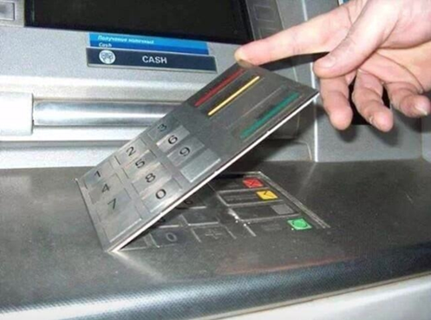

Slide 10
Challenges for Law Enforcement
Expertise of officer in handling Forensic Matters.
Digital Evidence Preservation and Presentation
Anonymity: Difficulty in tracking
Jurisdiction: Cross-border transactions complicate investigation
Limited Technology Advancement

Slide 11
Virtual Assets Explained!
Virtual assets refer to digital representations of value that can be traded, transferred, or used for payment electronically.
Cryptocurrencies - Bitcoin (BTC), Ethereum (ETH), and Litecoin (LTC)
Tokens – Basic Attention Token (BAT), tZERO, Tether (USDT).
Increasing Popularity in the Financial World
Technology – Blockchain Technology | Smart Contracts
Investment Opportunities - High Returns | Diversification
Decentralized Finance (DeFi) - Innovative Financial Services | Accessibility
Regulatory Developments - Regulatory Clarity | Central Bank Digital Currencies (CBDCs)

Slide 13
Regulation
National Payment Systems Act (2020) - An Act to regulate payment systems; to provide for the safety and efficiency of payment systems. This Act applies to— an operator of a payment system; a payment service provider; and an issuer of a payment instrument.
The NPSA currently excludes virtual assets from the oversight of the Central Bank (Bank of Uganda)
FIA conducts National Risk Assessments as per the FATF Recommendations
FIA has in place the Virtual Assets Working Group on the Money Laundering (ML)/Terrorism Financing (TF) Risk Assessment for Virtual Assets(VA) and Virtual Assets Service Providers(VASPS)for Uganda.

Slide 15
QUICK POINTERS
FIAT MONEY | DIGITAL CURRENCY
Backed by Governments | No backed by any Government
Controlled by Central Banks | No Central bank control
Transactional data held by banks and other licensed payment players | Transactional data stored on blockchain which shows only wallet addresses of senders and receivers
Global transactions move through licensed players | Use smart contracts for much faster global transactions
Can be forged | Can’t be forged due to use of advanced cryptography
Permissioned | Permissionless
Demands Know Your Customer (KYC) | Some digital currencies do not require KYC data

Slide 16
QUICK POINTERS
Example of a fiat type of bank account | Example of bitcoin account number
Ssebo Ssebo 12345678910 Munyonyo Branch Sente Bank Ltd | 1A1zP1eP5QGefi2DMPTfTL5SLmv7DivfNa
 | According to Chainalysis, illicit addresses sent nearly $23.8 billion’s worth of cryptocurrency

Slide 17
QUICK POINTERS – VIRTUAL ASSETS UGANDA REPORT
Revenue in the Cryptocurrencies market is projected to reach US$5.4m in 2024.
Revenue is expected to show an annual growth rate (CAGR 2024-2028) of 10.72% resulting in a projected total amount of US$8.1m by 2028.
The average revenue per user in the cryptocurrency market amounts to US$2.5 in 2024.

Slide 18
TOP REPORTED ILLEGAL AND CRIMINAL ACTIVITY

Slide 19
CRYPTO ASPECTS EXPLOITED BY CRIMINALS
ASPECT | NOTES
Anonymity | Transactions are made from one or more crypto addresses to one or more destination addresses
Lack of central authority | Transactions can be done between peers without involving a third party or done with exchanges that do not require KYC data
Speed and Borderless | Instant transfer and exchange of digital currency. There is no need to validate the transaction through a third party. E.g digital currency worth 20M UGX can be sent from the US and received in UG within minutes!
Easy storage | Digital in nature. No physical space is required as opposed to heavy and bulky notes

Slide 20
TOP REPORTED ILLEGAL AND CRIMINAL ACTIVITY
Scams
Cybercrime
Money Laundering
Fraud
Drug trafficking
Child exploitation
Dark marketplace business
Crime and Terror funding

Slide 21
TOP REPORTED ILLEGAL AND CRIMINAL CASHOUT TECHNIQUES
ASPECT | NOTES
Smurfing | Large sums of money are split into smaller amounts that are sent through via multiple transactions.
Mixing | These services are used to obscure the transaction history of a cryptocurrency by blending cryptos of multiple users.
Services based in high-risk jurisdictions | Services are located in areas flagged for deficiencies in their Anti-Money Laundering (AML) or Combating the Financing of Terrorism (CFT) systems
Fiat exchanges/ Over The Counter (OTC) | Convert crypto to cash, varying from mainstream to peer-to-peer (P2P) or non-compliant platforms
Privacy-Oriented Cryptocurrencies | Some blockchains employ advanced cryptographic techniques to hide transaction amounts, addresses, and other information.

Slide 22
Tools to Investigate Criminal Usage of Virtual Assets including Cryptocurrencies
Chainalysis: Provides transaction monitoring, investigations, and compliance solutions. It helps trace cryptocurrency transactions and identify suspicious activity across various blockchains.
Elliptic: Offers blockchain analytics and financial crime compliance solutions, enabling the tracking of illicit cryptocurrency transactions.
CipherTrace: Specializes in cryptocurrency intelligence and compliance, providing tools to analyze and trace transactions, as well as identify potential risks and illicit activities.
TRM Labs: Provides blockchain intelligence and forensics, helping organizations detect and respond to crypto-related fraud and financial crime.
AnChain.AI: Utilizes AI-powered analytics for forensic analysis, threat intelligence, and smart contract security.
Data Collection | Pattern Recognition | Transaction Tracing | Risk Scoring | Visualization

Slide 23
Other Laws
The Computer Misuse Act (2011) - make provision for the safety and security of electronic transactions and information systems.
The Electronic Transactions Act (2011) - provide for the use, security, facilitation and regulation of electronic communications and transactions; to encourage the use of e-Government services and to provide for related matters.
The Data Protection and Privacy Act (2019) - protect the privacy of the individual and personal data by regulating the collection and processing of personal information

Slide 24
Digital Forensic Science
A methodical series of techniques and procedures for gathering evidence, from computing equipment and various storage devices and digital media, that can be presented in a court of law in a coherent and meaningful format.- Dr. H.B. Wolfe
The preservation, identification, extraction, interpretation, and documentation of computer evidence, to include the rules of evidence, legal processes, integrity of evidence, factual reporting of the information found, and providing of expert opinion in a court of law or other legal and/or administrative proceeding as to what was found. – CSI
Forensics Computing is the science of capturing, processing, and investigating data from computers using a methodology whereby any evidence discovered is acceptable in a Court of Law.

Slide 27
Notes:
The "chain of custody" refers to the chronological documentation or paper trail showing the seizure, custody, control, transfer, analysis, and disposition of physical or electronic evidence. It is a crucial component of the legal system, particularly in criminal cases, to ensure the integrity and admissibility of evidence in court. Here's an overview of the concept and its importance:
Collecting digital evidence requires adherence to strict protocols to ensure its integrity and admissibility in court. Here are some best practices:
Document the Scene: Record the condition of the digital environment, including hardware, software, and network configurations. Document any relevant information such as timestamps, system settings, and user accounts.
Chain of Custody: Establish and maintain a clear chain of custody for the evidence from the moment it is collected until it is presented in court. Ensure that every person who handles the evidence documents their actions, including collection, storage, and transportation.
Forensic Imaging: Create forensic images (bit-by-bit copies) of storage devices containing digital evidence. Use write-blocking hardware or software to ensure that the original evidence remains unchanged during the imaging process.
Hashing and Digital Signatures: Generate cryptographic hashes of the original evidence and forensic images using algorithms like SHA-256. Compare hashes to verify the integrity of the evidence at different stages of the investigation. Digital signatures can further authenticate the integrity of the evidence.
Documentation and Metadata: Document all relevant information about the evidence, including metadata such as file timestamps, file paths, and user activity logs. Maintain detailed notes of the collection process, including the tools and techniques used.
Data Preservation: Ensure the preservation of evidence in its original state to prevent alteration or contamination. Store digital evidence in secure, controlled environments with restricted access to authorized personnel only.
Authentication and Verification: Verify the authenticity of digital evidence by examining metadata, file properties, and digital signatures. Use forensic software tools to analyze and validate the integrity of the evidence.
Expert Testimony: Seek expert testimony from qualified digital forensics professionals to explain the collection process, analysis techniques, and findings to the court. Experts can provide technical expertise and credibility to support the admissibility of the evidence.
Adherence to Legal Standards: Follow established legal standards and guidelines for collecting, preserving, and presenting digital evidence in court. Familiarize yourself with relevant laws, regulations, and court precedents to ensure compliance throughout the investigation process.
Documentation of Analysis Methods: Document the methods and techniques used to analyze digital evidence, including forensic tools, search parameters, and examination results. Maintain transparency and accuracy in the analysis process to support the reliability of the findings.
Preparation for Cross-Examination: Anticipate challenges to the authenticity and integrity of digital evidence during cross-examination. Prepare detailed explanations and documentation to address any questions or objections raised by opposing counsel.
Continual Training and Education: Stay updated on advancements in digital forensics techniques, tools, and legal requirements through ongoing training and education. Maintain proficiency in digital investigation practices to ensure effectiveness and credibility in court proceedings.

Slide 29
Presentation of Digital Evidence in Court
Admissibility of Digital Evidence
Authentication | Relevance | Reliability
Presentation Techniques
Organized Evidence | Visual Aids | Demonstrative Exhibits | Expert Testimony

Slide 30
Key Challenges
Lack of adequate skilled technical teams to investigate complex virtual Asset and digital crime
Lack of oversight for virtual assets
Technological Complexity
Cross-Border nature given that most digital payment platforms and virtual asset systems are majorly located outside Uganda
Budget Constraints given that digital forensics investigation tools are expensive

Slide 31
Recommendations
Continuous Awareness
Formation of Specialized Courts
Investment in Technology
Inter-Government Agency Cooperation – Taskforces, System Integrations
Experiential Benchmarking with Developed Regions
Development of a Financial Investigation Curriculum for Law Enforcement and Judiciary

Slide 32
General Tips on Personal Cyber Hygiene
Use Strong, Unique Passwords for Payment Accounts
Enable Multi-Factor Authentication (MFA)
Keep Payment Apps and Systems Updated
Be Cautious with Emails and Links Related to Payments
Use Antivirus and Anti-Malware Software
Secure Your Networks for Payment Transactions
Be Mindful of Sharing Payment Information on Social Media
Monitor Your Payment Accounts

Slide 33
THANK YOU

