Slide 1
PERSONAL FINANCE CAPABLITY
The 4 Pillars
Headmaster, Hoima

Slide 2
“MONEY IS NOT EVERYTHING BUT EVERYTHING NEEDS MONEY”
headmaster.atwork.co.za

Slide 3
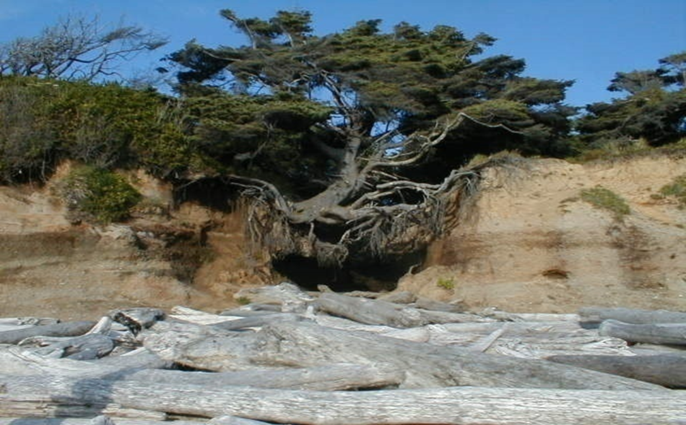
Working on Appearances …ignoring reality

Slide 4
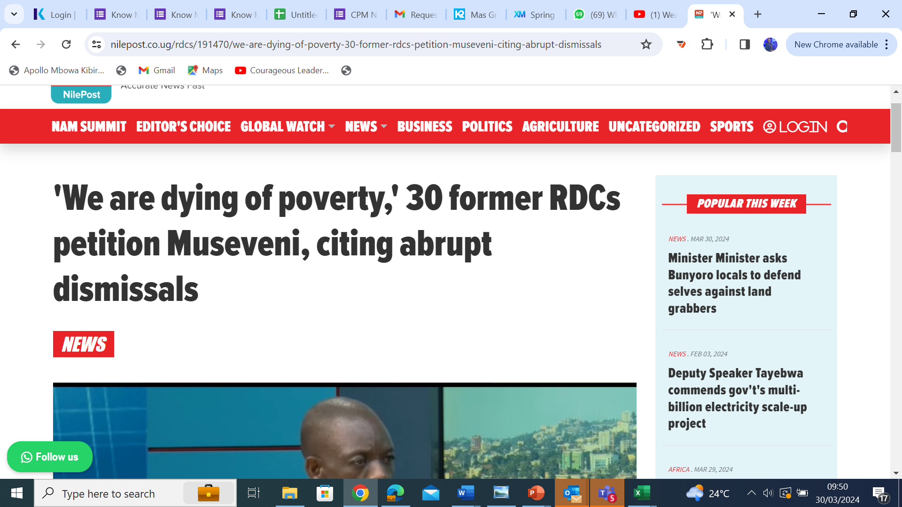
COPORATE GOLDMINE OVER TIME…THE HERE AND THERE
GRATITUATY
headmaster.atwork.co.za

Slide 5
The Numbers….In the ROOM….The Story
Have Money Experience…as old as they are.
100%
93%
Have only NSSF as their savings
Are Millionaires…lumpsum, Routine or cumulative
100%
80%
Have exhausted their retirement saving under 2 years
Spend more than we earn
?
5%
Have, maintain Financial independence after retirement
Spent Worried about Money Daily
3Hrs
100%
Will Retire….and get There
headmaster.atwork.co.za

Slide 6
Let's catch up….affirm to the neighbor
We differentiate KNOWING from UNDERSTANDING
We separate POSSESSIONS from ASSETS
We know HEARING but cherish LISTENING
We do not confuse LOOKING and SEEING
We do not engage in MOVEMENt without PROGRESS
We stopped LOOKING for money and started MAKING money
We EARN money monthly…and SAVE money monthly
There are The Poor, The Broke, The Rich and the Wealth-we know our ADDRESS
We are know and understand that GROWING OLD is Mandatory but GROWING UP is optional

Slide 7




Better Financial Capability = Better LIFE
Our Member
facts, information, and skills acquired through experience or education; the theoretical or practical understanding of a subject..
YOU
KNOWLEDGE
Financial Capability
BEHAVIOR
ATTITUDES
the way in which one acts or conducts oneself, especially towards others..
a settled way of thinking or feeling about something.

Slide 8
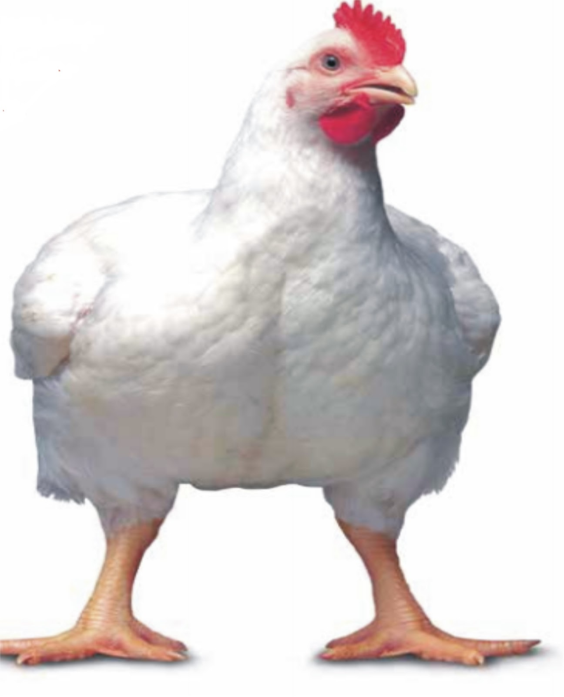
1
KNOWLEDGE

Slide 9
Knowledge Test….
If a book and a pen cost Shs.11000/- The book costs Shs 10,000/= more that than the pen.
How much does the Pen Cost?
It takes five machines five minutes to make five donuts. How long will it take 100 machines to make 100 donuts
In a lake, there is a water weed cover. Every day, the weed cover doubles in size. If it takes 48 days for the patch to cover the entire lake, how long would it take for the patch to cover half of the lake?

Slide 10
Do you KNOW…..
Your savings BALANCE?
Your Verified money EXPERIENCE?
That you will RETIRE?
Money growth is not magic but rather TIME?
The difference between Your money EXPERIENCE and money EXPERTISE is KNOWLEDGE?

Slide 11
HERE
T
headmaster.atwork.co.za

Slide 12
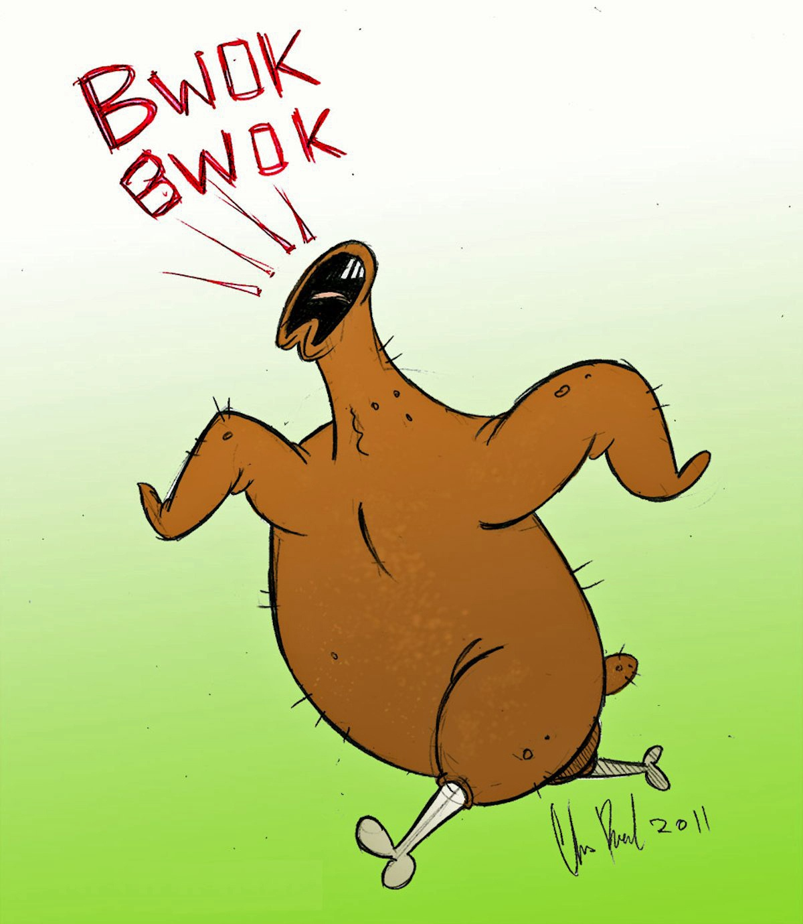
2
ATITUDE

Slide 13
If you ONLY knew……
Your Attitude….?

Slide 14
That Your problems are yours……..
That your problems didn't start with employment with Government
That you are the best solution to your problems- not government, not NSSF, Not Judiciary,not your employer
That school fees problem is relative...you pick your choice
That the law won't change today to give you money...but you can change your money habits TODAY
that wealth is habits, attitude, behavior and 5% money, you would stop looking for money and start making money
You grew up eating other people's Money...you would plan for the next generation to eat your money - don't be selfish
Poverty is a choice…demeans, denies you of opinion, life and voice
That the older you become, the wiser you become and the wealthier you should be
THAT YOU ARE OVERPAID- YOU WOULD SAVE

Slide 15
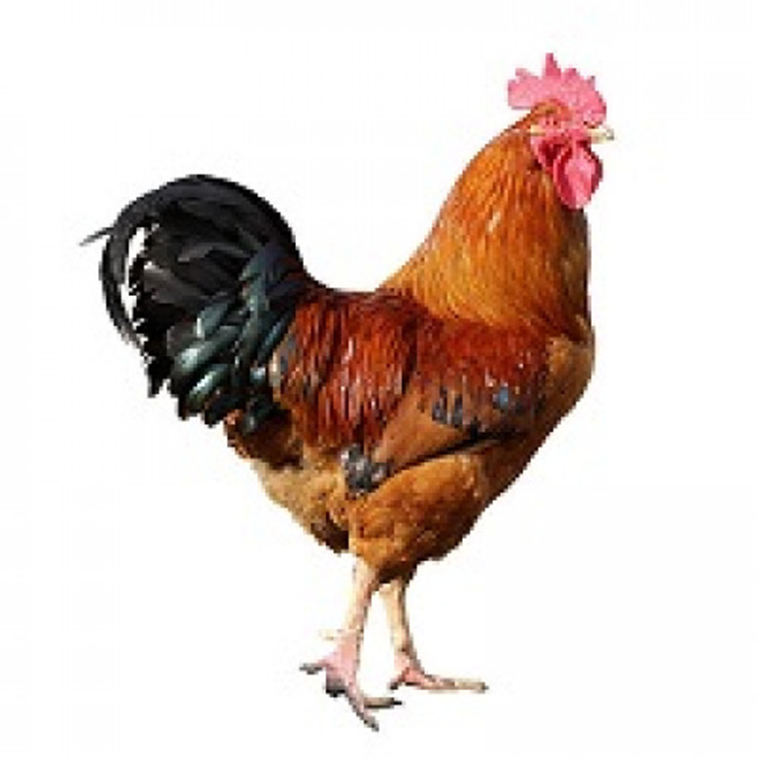
3
BEHAVIOUR

Slide 16
The Wealth cycle
1
2
3
4
5
GET IT
KEEP IT
GROW IT
SUSTAIN IT
EAT IT
Admit you are over paid.
See it as an opportunity to keep the overpayment
Below your means Task: not easy but doable…
Save before your spend.
Spend formulars
Wealth should outlive you: Revising, refining, and finalizing.
Prepare your children…don’t prepare for them
Prepare a will:
.
Skill: Components, characteristics, objectives, and substitutes.
Hard work.
You are paid for Value not existence.
Saving with no growth is dead: interest is growth
Explore option that don’t require your time…no business in business if you not performing at the main hassle
Eat the eggs not the hen: Revising, refining, and finalizing.
Not eating money is financial indiscipline:
Options
Options
Options
Options
Options
Unit trusts
Investment clubs
SACCO
Financial Mkts
Business
Celebrate small wins
Small but frequent celebration
Charity
PARTY...
Work
Skill Hassle
Passive…
  Bank
Assets
SACCO
Organize, Preparation and complete record.

Slide 17
Get in Behavior….
Behavior of Action
Behavior that Appreciate the Process
Behavior of Spend after Saving
Behavior of Purpose
To move from Working for Money to Money working for you
Discipline of Skill and Hard Work

Slide 18

DISCIPLINE
Save
Invest
Your are a Business and your profit is what you are able to save and Invest off your Sales Income (Salary)

Slide 19

4
YOU

Slide 20
1.
If you do not SAVE money…money won't save you

Slide 21
2.You need to Grow Up…not just grow Old
I have a wife and children now
You beg around
You know a lot …you understand little-seat belt test
Look down on your boss because of age
Have work experience not expertise

Slide 22
Litmus Test
New Salary excites you for 3 months
Your “needs” multiply faster than your increment
You wont quite if your salary is cut into half
No one demands you for a premium
You think you are overworked
You added no skill from your first employment
3.You Are Over PAID

Slide 23

If you ONLY knew……
HERE WILL BECOME THERE

Slide 24

THANK YOU

