Slide 1
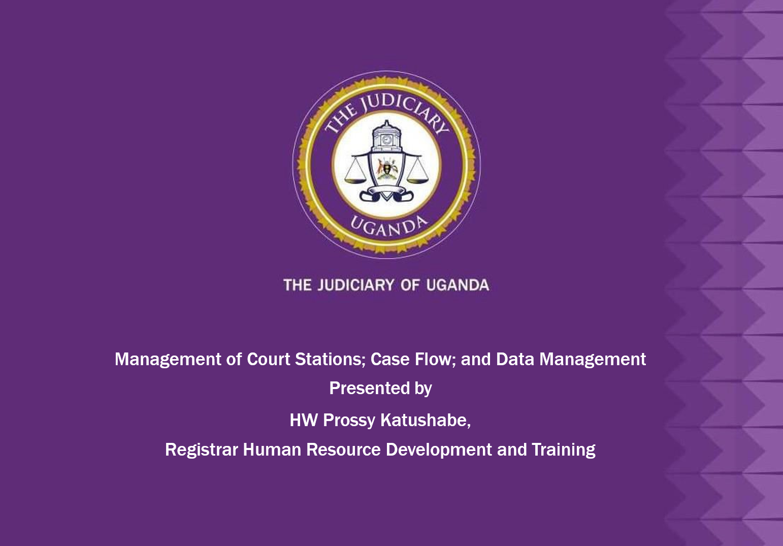

Slide 2
Introduction and layout
Overview of management of court stations
Management of Court stations
Best Practices in Court station management
Case flow management
Importance of efficient case flow management
Strategies for effective case flow management
Challenges in case flow management
2

Slide 3
Overview of management of court stations
1. The management of courts in Uganda is done through a structure. This is the structure of the Judiciary as laid down in the Constitution and other related laws.
Management of courts entails judicial administration, leadership, application of processes and procedures in a legal setting to address the needs of communities through timely and expeditious case disposal, Providing fairness and equality in an environment founded on integrity to ensure access to our courts by everyone
3

Slide 4
Court stations management
Key management functions:
Human resource allocation
Budget and resource management
Infrastructure and logistics
Registry management
Adjudication of cases
The inspectorate function of a judicial officer
4

Slide 5
Best practices in court station management
Staff training and capacity building
Implementation of performance management systems
Adequate financial and logistical planning
Stakeholder engagement and collaboration
Open communication
Management of a registry
Case file management
Use of technology
Supervision
5

Slide 6
Case flow management
Definition and significance of case flow management
Efficient case flow management is aimed at minimizing the delays , reduce costs on the part of the litigant, streamlining the processes at the court for easy access by the court users.
Stages of case flow:
Filing and registration
Pre-trial management
Hearing and adjudication
Judgment and execution
Achieving
6

Slide 7
Key factors in case flow management
Case assessment majorly on what is required and create appropriate case management strategies.
Scheduling and creating realistic time frames.
Keep the file / case active by regular monitoring to detect unnecessary delays and address any procedural issues that may arise.
Track progress on a daily to avoid creating backlog and efficient
Manage documents/ system. Use technology as much as possible
Regular stakeholder engagement especially those that are involved in court processes
Set realistic goals and targets
7

Slide 8
Strategies for effective case flow management
Use of Alternative Dispute Resolution (ADR)
Adoption of case management tools (ECCMIS, CCAS, cause lists, and adoption of technologies like artificial intelligence (AI))
Strengthening judicial capacity and court automation.
Strict adherence to case time standards
8

Slide 9
Challenges in case flow management
Case backlog and delays
Limited judicial officers and support staff
Logistical and infrastructural constraints
Poor coordination among stakeholders
Identification of inefficiencies in case flow and making recommendations
9

Slide 10
Data management in courts
Definition and role of data management in judicial operations
Data management is the process, practices, technologies used to collect data and store it.
The role of data management
It’s the only way to manage the life cycle of the case.
Accessibility of the data in our custody file for example the judgements and court record
Helps in accurate reporting. Note: standards have to be put electronically or manually to have accurate data
Ensure privacy and data security of court data
The processes of how to access, collect, retain, achieve and destroy the court records.
10

Slide 11
Data management in courts
Key components:
Case records management
Digital transformation and automation
Data security and confidentiality
Data storage and retrival
11

Slide 12
Definition and role of data management
Easy access to court documents
Use in decision making and policy making
Quick disposal of cases as you know the status of the information with you
Discovering bottlenecks in the Court system
Understanding the trends of the Court
12

Slide 13
Challenges in court data management
Poor record-keeping practices
Inadequate ICT infrastructure
Loss and misplacement of files
Archival issues
Resistance to digital transformation
Lack of transperancy in the processesof data management
Intergrity of the data especially for data that is transformed from paper to digital
Inconsistences in entering the data can affect efficiency and cause problems
Lack of adequate training in data management and handling
13

Slide 14
Solutions for effective data management
Secure and organize files
Use technology like ECCMIS and CCASS to improve efficiency
Manage court schedules effectively.
Train and supervise staff.
Manage and monitor the engine of the court which is the registry
14

Slide 15
Conclusion
Summary of key points:
Efficient management of court stations enhances service delivery
Case flow management reduces backlog and delays
Data management ensures transparency, accountability, and efficiency
All this is aimed at building public confidence in your Court .
“Effective court management, seamless case flow, and robust data systems are the pillars of a responsive judiciary. Let’s commit to excellence in justice administration"
15

Slide 16
Questions
16

