Slide 1
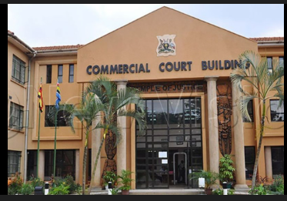

Alternative Dispute Resolution in Commercial Justice Administration
Judges' Conference Presentation
Justice Anna B. Mugenyi
2nd February 2025
Commercial Court attains 30 years of delivering Commercial Justice

Slide 2


Presentation Outline
What is Commercial Justice?
What is Alternative Dispute Resolution?
Role of ADR in Commercial Justice Administration
Court-ADR Interface
ADR Legal Framework in Uganda
ADR Challenges in the Administration of Commercial Justice
Recommendations and Best Practices
ADR and Judicial Health & wellness
Commercial Court attains 30 years of delivering Commercial Justice

Slide 3

What is Commercial Justice?
It balances private commercial interests with public economic policy by ensuring predictability, integrity and accountability in commercial dealings
Commercial Justice refers to the fair, efficient and effective resolution of disputes arising from commercial, business, trade and employment.
It encompasses the application of legal principles to regulate transactions, contracts, investments, labour relations and corporate conduct.
Commercial Court attains 30 years of delivering Commercial Justice

Slide 4
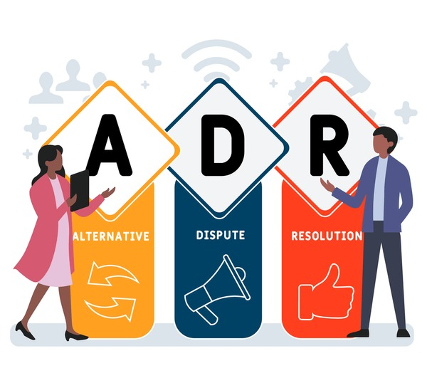
What is Alternative Dispute Resolution?
ADR refers to a range of Non-Judicial mechanisms used to resolve commercial disputes outside the traditional court process. In the administration of commercial justice, ADR plays a vital role in promoting efficiency, flexibility, and business-friendly dispute resolution.
Commercial Court attains 30 years of delivering Commercial Justice

Slide 5
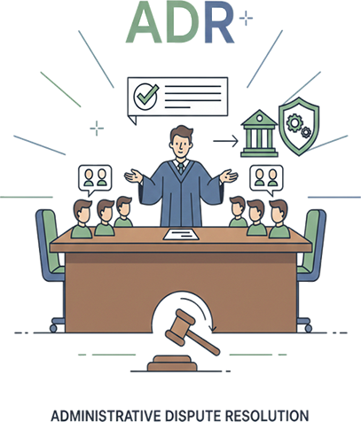
ADR in Administration of Commercial Justice
Rationale:
In Commercial Justice, ADR is employed to resolve disputes arising from business, trade, finance, investment and contractual relationships through consensual or private adjudicative processes.
The use of ADR is driven by the need to;
Reduce Court congestion
Minimise delays and costs
Preserve commercial relationships
Provide specialised and confidential dispute resolution
Commercial Court attains 30 years of delivering Commercial Justice

Slide 6

Main forms of ADR in Commercial Justice
A)Arbitration
A private binding dispute resolution process where parties submit their disputes to one or more neutral arbitrators.
Ideal for high value, complex, and cross broader commercial disputes
Arbitral awards are enforceable like Court judgments, including internationally under the New York Convention
Courts support arbitration through stay of proceedings, interim measures and enforcement of awards
B) Mediation
A voluntary confidential process in which a neutral mediator assists parties to reach a mutually acceptable settlement.
Non-binding unless a settlement agreement is reached.
Encourages commercial pragmatism and preservation of business relationships
Increasingly integrated into Court-Annexed commercial justice systems.
C) Conciliation
Similar to mediation but the conciliator may take a more active role by proposing settlement terms.
Common in commercial and investment disputes.
D) Negotiation
Direct discussions between parties and/or their representatives
Often the first step in commercial dispute resolution and commonly required by contract.
Commercial Court attains 30 years of delivering Commercial Justice

Slide 7
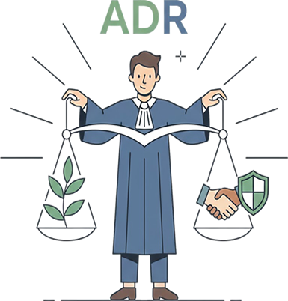
Role of ADR in Commercial Justice Administration
Enhancing access to Justice through faster and less formal procedures
Reducing backlog in the Commercial Division and other Courts
Promoting party autonomy, allowing businesses to choose procedures, decision makers and timelines.
Ensuring confidentiality which is critical in sensitive commercial matters.
Supporting judicial efficiency as Courts supervise, enforce and compliment ADR processes
Commercial Court attains 30 years of delivering Commercial Justice

Slide 8

Court-ADR Interface
Modern commercial justice systems adopt a complementary approach:
Courts may refer parties to ADR at pre-trial or case management stages.
Courts enforce ADR clauses, arbitral awards and mediated settlements.
Judicial intervention is limited to support and supervision, not interference.
Commercial Court attains 30 years of delivering Commercial Justice

Slide 9

Policy and Developmental Importance
ADR in commercial justice:
Improves the business and investment climate.
Aligns with international best practices
Promotes peaceful, efficient resolution of commercial disputes.
Strengthens confidence in the legal and judicial systems.
Commercial Court attains 30 years of delivering Commercial Justice

Slide 10

Way Forward
ADR is an indispensable pillar of commercial justice administration. By offering flexible, efficient, and business-oriented dispute resolution mechanisms, ADR complements formal adjudication and ensures that commercial disputes are resolved in a manner that supports economic growth, judicial efficiency and the rule of law.
Commercial Court attains 30 years of delivering Commercial Justice

Slide 11
ADR Legal Framework In Uganda
The 1995 Constitution- Article 126(2) (d) and (e) –mandates courts to promote reconciliation and ADR
Judicature Act (Cap 16) – inherent powers of courts
Civil Procedure Act Cap 282 and Rules (SI 71-1) – Procedures such as scheduling lead to agreed facts, issues
Arbitration and Conciliation Act (Cap 5)- statutory arbitration framework.
Draft Judicature (Court-Annexed mediation) Rules 2025
National ADR Policy 2025
Commercial Court attains 30 years of delivering Commercial Justice

Slide 12
Challenges Relating to ADR in Administration of Commercial Justice
1. Limited utilisation despite legal framework.
Although mediation is provided for, many commercial disputes still proceed to full trial.
ADR is often viewed as a procedural formality rather than a genuine dispute resolution.
2. Case backlog and delays in Courts.
High case volumes in the Courts reduce the time available for effective case management and early ADR referral.
Delays undermine confidence in both litigation and ADR outcomes.
3. Capacity Constraints.
Limited number of specialized commercial mediators and arbitrators, especially outside Kampala
An uneven quality of ADR services due to inconsistent training and accreditation.
Commercial Court attains 30 years of delivering Commercial Justice

Slide 13
Challenges contd.
4. Enforcement Challenges.
Applications to set aside arbitral awards or resist enforcements are frequently used to delay finality.
Lengthy enforcement procedures dilute the advantages of arbitration.
5. Cost Barriers.
Institutional arbitration and professional fees remain high for SMEs.
Perception that arbitration is only suitable for large or international disputes.
6. Inconsistent Judicial Approach.
Variations in how Judges encourage, refer, or manage ADR across the Courts.
Occasional over intervention in arbitral matters contrary to the principle of minimal court interference.
7. Awareness and Cultural Attitudes.
Limited understanding of ADR among small businesses and informal commercial actors.
Strong preference for authoritative judicial determination.
Commercial Court attains 30 years of delivering Commercial Justice

Slide 14
Recommendations Relating to ADR in Administration of Commercial Justice
1. Strengthen Court-Annexed Mediation
Make early mandatory mediation screening a consistent practice in all cases
Enhance collaboration between the Courts and ADR institutions.
2. Judicial Capacity Building
Continuous training for Judges on case management, mediation referral, and arbitration-friendly jurisprudence
Development of ADR practice direction specific to the Divisions of the High Court.
3. Improve Enforcement Efficiency
Streamline procedures for recognition and enforcement of arbitral awards.
Actively discourage dilatory tactics through firm cost orders and strict timelines.
4. Expand Regional Access
Develop ADR capacity in up-country High Court Circuits
Encourage decentralisation of mediation and arbitration services beyond Kampala.
5. Promote SME-Friendly ADR
Introduce simplified and low-cost mediation and arbitration tracks for SMEs.
Encourage pre-dispute ADR clauses in standard commercial contracts
6. Harmonise Legal Frameworks.
Review and update the Arbitration and Conciliation Act to align with modern international standards and local realities.
Strengthen linkage between mediation rules and civil procedure framework.
Commercial Court attains 30 years of delivering Commercial Justice

Slide 15
Recommendations contd.
7. Awareness and Stakeholder Engagement
Targeted sensitisation of the business community, banks, insurers, regulators, lawyers and other actors in the commercial justice system.
Judicial outreach programs highlighting successful ADR outcomes.
8 Policy Support and Institutional Strengthening
Increased budgetary and policy support for ADR institutions
Establish national standards for accreditation, ethics, and performance monitoring of ADR practitioners.
Commercial Court attains 30 years of delivering Commercial Justice

Slide 16
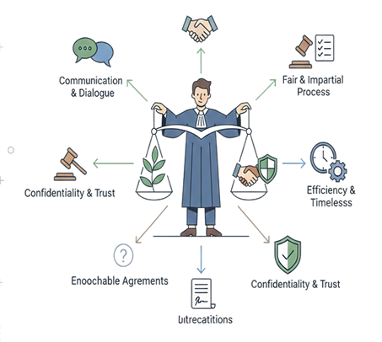
Best Practices of ADR in Commercial Justice
1. Legal and institutional framework
2. Guiding principles for judicial use of ADR
Appropriateness, party autonomy, neutrality and impartiality, confidentiality, proportionality, finality and enforceability.
3. Identifying cases suitable for ADR
4. Timing of ADR referrals.
5. Court-Annexed mediation: Judicial dos and don’ts.
6. Arbitration best practices for the Judges
Respect for arbitration agreements, limited judicial intervention, interim measures and enforcement of awards.
7. Costs, incentives and sanctions.
8. Ethical and procedural safeguards.
9. Record keeping and performance monitoring.
10. Continuous judicial developments
Commercial Court attains 30 years of delivering Commercial Justice

Slide 17

How ADR Promotes Judicial Health & Wellness
Judicial wellness encompasses the mental, emotional, professional, and institutional well being of Judges, enabling them to perform their duties effectively, independently, and sustainably.
ADR plays a significant and often under-appreciated role in promoting judicial awareness particularly in busy Courts:
1. Reduction of case backlog and workload pressure
Wellness impact: Less cognitive overload, reduced burnout and improved work-life balance.
2. Shorter and more predictable case timelines
Wellness impact: Greater control over-time, reduced frustration, and enhanced professional satisfaction.
Commercial Court attains 30 years of delivering Commercial Justice

Slide 18
How ADR Promotes Judicial Health & wellness
3. Reduced adversarial intensity
Wellness impact: Lower emotional strength and reduced secondary stress associated with adversarial disputes
4. Improved quality of judicial decision making
Wellness impact: Increased confidence, professional pride and intellectual fulfilment.
5. Enhanced sense of judicial efficacy and purpose
Wellness impact: Greater job satisfaction and reduced cynicism.
6. Lower risk of complaints and conflicts with Court users
Wellness impact: Reduced anxiety related to complaints, appeals, or public scrutiny.
7. Institutional support and collegiality
Wellness impact: Stronger collegial support and institutional resilience
Commercial Court attains 30 years of delivering Commercial Justice

Slide 19

How ADR Promotes Judicial Health & wellness
8. Psychological distance from outcomes
Wellness impact: Lower emotional burden and reduced risk of compassion fatigue.
9. Alignment with modern judicial identity
Wellness impact: Greater sense of professional control and reduced role strain.
10. Sustainable justice delivery
Wellness impact: Long-term judicial health and institutional stability.
Commercial Court attains 30 years of delivering Commercial Justice

Slide 20

Conclusion
ADR promotes judicial wellness by reducing overload, lowering emotional strain, improving professional satisfaction and fostering a healthier justice eco-system for all Court Judges.
ADR is not merely a procedural tool, it is a wellness strategy that enables sustained excellence for effective case management.
Commercial Court attains 30 years of delivering Commercial Justice

Slide 21


